Slide 1
Dublin Business School — HDip in Data Analytics
Detecting Mental Distress in Social Media Posts
Using Machine Learning
Presented By:
Student Name: May Hnin Khaing
Student Number: 20083323
Final Project | Supervisor: Nitya Govindaraju | July 2026

Slide 2




Introduction
Why detecting mental distress in social media text matters
Social signals
Social media posts often reflect individuals’ emotional states and can contain early indicators of psychological distress. Many people express signs of anxiety, depression, and emotional struggles online before seeking professional support.
Pandemic context
The COVID-19 pandemic increased global mental health challenges, with the World Health Organization (WHO, 2022) reporting a significant rise in anxiety and depression worldwide.
ML approach
This project explores whether machine learning-based text classification can identify patterns of mental distress in social media posts.
Project aim
The aim is to support early awareness, monitoring, and potential intervention through automated text analysis.

Slide 3
Literature Review
CRISP-DM
TF-IDF
Model Selection
Most widely adopted ML framework, iterative structure suits noisy social media text (Chapman et al., 2000)
Widely validated baseline for text classification, weights words by importance across corpus (Sparck Jones, 1972)
Systematic review of 47 studies confirmed LR (18), SVM (15), RF (12), NB (7) as most used models (Hasan et al., 2026)
Interpretability
class_weight
Future Directions
Fundamental trade-off - simpler models provide clinical transparency while black box models exploit complex patterns
Applied to LR, SVM and RF to handle mild class imbalance (1,774–2,170 samples) without synthetic oversampling
BERT and MentalBERT show strong performance, but traditional ML remains competitive on medium datasets (Kallstenius et al., 2025)

Slide 4
Methodology — CRISP-DM Framework
1
2
3
4
5
Business Understanding
Data Understanding
Data Preparation
Modelling
Evaluation
Define problem, objectives and research question
Class distribution, text length, word frequency analysis
NLP preprocessing, TF-IDF vectorisation, train test split
Grid Search + 5-Fold Stratified CV across 12 model runs
Accuracy, Precision, Recall, F1, CV Accuracy, AUC-ROC
Deployment phase excluded — purely analytical study

Slide 5
Business Understanding
Problem Statement
Business Need
Mental health disorders affect 1 in 8 people globally
People express distress online before seeking professional help
Early detection can support timely clinical intervention
Social media provides real time signals of psychological distress
Automated classification can assist mental health professionals
Proposed Solution
Stakeholders
Apply ML to classify posts into 5 distress categories
Provide interpretable predictions that clinicians can trust
Establish a baseline for future AI driven mental health tools
Mental health professionals and clinical practitioners
Healthcare organisations and social media platforms
Researchers, policymakers and early intervention services

Slide 6
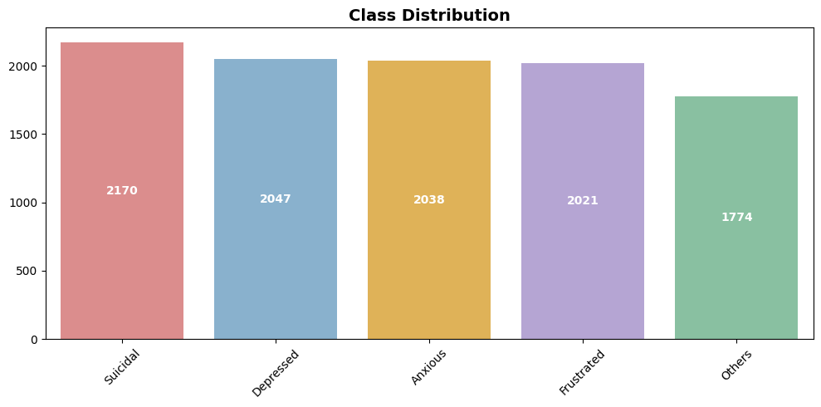
Dataset
MentalDistress Dataset
Prity et al. (2026) — Mendeley Data
Columns
Text, Label
Original records
10,100
After missing removal
10,098
After duplicate removal
10,050
5 Target Variables
Suicidal
Depressed
Anxious
Frustrated
Others
Class Distribution

Slide 7
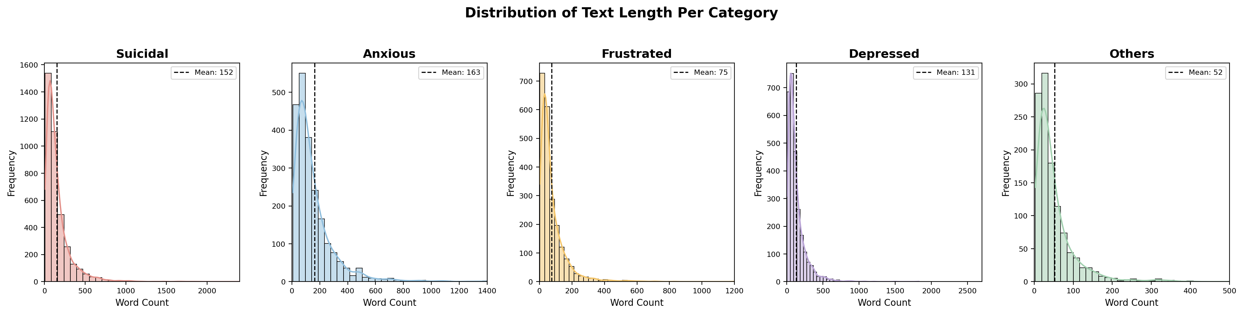
Distribution of Text Length Per Category
Post length varies noticeably across psychological categories

Slide 8





Data preparation - Text Preprocessing
A five-step pipeline to clean and normalize raw text before feature extraction
1
2
3
4
5
Lowercase
Contraction Expansion
Punctuation Removal
Stopword Removal
Lemmatisation
Each step feeds into the next, progressively normalizing raw social media text ahead of TF-IDF vectorization.

Slide 9
Data Modelling
Train Test Split
Training set (80%)
8,040 rows
Test set (20%)
2,010 rows
Strategy
Stratified split
TF-IDF fitted on
Training data only — no leakage
Classification Models
Logistic Regression
Naive Bayes
SVM
Random Forest
Type: Interpretable
Type: Interpretable
Type: Black Box
Type: Black Box
Grid Search
5-Fold Stratified CV
3 Features
12 model runs
Hyperparameter optimisation
Validation strategy
Unigram, UniBigram, UniTrigram
4 models × 3 feature sets

Slide 10
Results Overview — All Feature Sets
Unigram (1,1)
UniBigram (1,2)
UniTrigram (1,3)
Model | Acc | F1 | CV Acc | AUC-ROC
LR | 0.7945 | 0.7935 | 0.7653 | 0.9515
NB | 0.7090 | 0.7010 | 0.6808 | 0.9324
SVM | 0.8005 | 0.7971 | 0.7713 | 0.9433
RF | 0.7741 | 0.7648 | 0.7409 | 0.9411
Model | Acc | F1 | CV Acc | AUC-ROC
LR | 0.7955 | 0.7949 | 0.7703 | 0.9524
NB | 0.7214 | 0.7166 | 0.6981 | 0.9301
SVM | 0.8050 | 0.8011 | 0.7715 | 0.9450
RF | 0.7791 | 0.7721 | 0.7310 | 0.9387
Model | Acc | F1 | CV Acc | AUC-ROC
LR | 0.7970 | 0.7966 | 0.7684 | 0.9524
NB | 0.7189 | 0.7140 | 0.6979 | 0.9296
SVM | 0.8045 | 0.8004 | 0.7716 | 0.9449
RF | 0.7741 | 0.7655 | 0.7341 | 0.9379
Key Observations
• Best Accuracy:
SVM UniBigram — 0.8050
• Best AUC-ROC:
LR UniBigram = LR UniTrigram — 0.9524
• Best F1 Score:
SVM UniBigram — 0.8011
• Worst overall:
Naive Bayes across all feature sets
• Best CV Accuracy:
SVM UniTrigram — 0.7716
• Combined features:
Consistently outperform Unigram alone

Slide 11
Logistic Regression vs SVM — Head to Head
Logistic Regression
SVM
Metric | LR UniBigram | SVM UniBigram | LR UniTrigram | SVM UniTrigram
Accuracy | 0.7955 | 0.8050 | 0.7970 | 0.8045
Precision | 0.7959 | 0.8044 | 0.7979 | 0.8039
Recall | 0.7979 | 0.8068 | 0.7994 | 0.8062
F1 Score | 0.7949 | 0.8011 | 0.7966 | 0.8004
CV Accuracy | 0.7703 | 0.7715 | 0.7684 | 0.7716
AUC-ROC | 0.9524 | 0.9450 | 0.9524 | 0.9449
Interpretable | Yes | No | Yes | No
SVM Wins
LR Wins
Gap Is Minimal
LR Recommended
Accuracy, F1, Precision
Recall and CV Accuracy
AUC-ROC across ALL
feature sets - 0.9524
Accuracy gap < 1%
CV gap < 0.2%
Highest AUC-ROC +
Full interpretability

Slide 12







Future Work & Limitations
Where this study could go next, and what constrained it this time
FUTURE WORK
LIMITATIONS
English-only — dataset limited to English posts, affecting generalisability.
Deep Learning — LSTMs, CNN-BiLSTM for sequential dependency modelling.
Clinical complexity — social media posts may not fully reflect clinical presentations.
BERT — domain-specific transformer for mental health text.
Analytical Scope — Study is purely analytical, real world deployment requires clinical validation and regulatory approval.
MentalBERT — pre-trained on mental health corpora.
LLaMA — large language model fine-tuning and comparison.
Multilingual — extend beyond English-language posts.

Slide 13
Conclusion
Recommended Model: Logistic Regression + UniTrigram TF-IDF
Accuracy: 0.7970 | F1: 0.7966 | CV Accuracy: 0.7684 | AUC-ROC: 0.9524 | Fully Interpretable
Key Findings
Traditional machine learning models effectively classified five psychological distress categories from social media text.
TF-IDF with n-gram representations improved classification performance by capturing contextual information.
SVM (UniBigram) achieved the highest predictive performance (Accuracy = 0.8050, F1-score = 0.8011).
Performance gap between LR and SVM < 1%
Logistic Regression (UniTrigram) was selected as the recommended model due to its competitive performance, highest AUC-ROC (0.9524), and greater interpretability.

Slide 14
Thank you for your attention.

